Slide 1

第十四章 贝叶斯网络

Slide 2
内容提要
贝叶斯网络
贝叶斯的语义
贝叶斯网络的精确推理

Slide 3
独立性
如果 ，则这两个变量是独立的。
独立性是一个简化模型的假设
Notes:
But just how big these UGCs are. On average, in every 60 seconds in social media, two million videos are viewed on YouTube, 700,000 messages are delivered by way of Facebook, 175,000 tweets are fired off into the ether, and 2,000 Foursquare check-ins tell the world where we are. When considered together, one thing seems clear: social media has taken over the world.

Slide 4


独立性例子
N 次随机选择, 硬币翻转独立性:
P(X₁)
P(X₂)
P(X_{n})
H | 0.5
T | 0.5
H | 0.5
T | 0.5
H | 0.5
T | 0.5
P(X₁, X₂, …, X_{n})
2^{n}

Slide 5

条件独立性
P(Toothache, Cavity, Catch) 去掉不相关的条件，简化计算！
如果我有cavity,探针在里面检测到catch的概率并不取决于我是否有toothache: （catch和toothache无关）
P(+catch | +toothache, +cavity) = P(+catch | +cavity)
如果我没有cavity，同样具有独立性:
P(+catch | +toothache, -cavity) = P(+catch | -cavity)
给定cavity，catch是 toothache的条件独立:
P(catch | toothache, cavity) = P(catch | cavity)

Slide 6
条件独立性
等效语句:
P(Toothache | Catch , Cavity) = P(Toothache | Cavity)
P(Toothache, Catch | Cavity)
= P(Toothache | Cavity) P(Catch | Cavity)
变量之间的独立性和条件独立性可以大大减少完全联合概率分布的计算开销 （去掉无关的条件，类似特征提取）

Slide 7

条件独立性
条件独立性是我们关于不确定环境中的知识最基本的形式
对于给定条件Z，X是Y的条件独立性
1. 当且仅当（充要条件）:
2. 等价地,当且仅当:

Slide 8
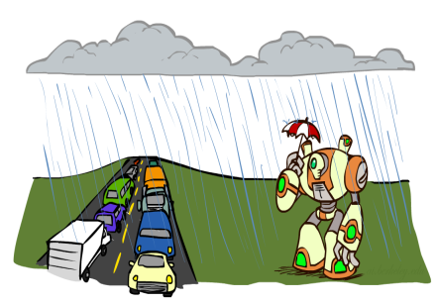
条件独立性和链式法则
链式法则:
考虑3个变量（交通拥堵,下雨,雨伞）的事件:
判断P(Traffic)P(Rain|Traffic)(Umbrella|Rain, Traffic)?
事件的原因（条件）Rain

Slide 9
条件独立性和链式法则
考虑3个变量（交通拥堵,下雨,雨伞）的事件:
随着Traffic 和Umbrella 独立的条件独立性的假设:

Slide 10
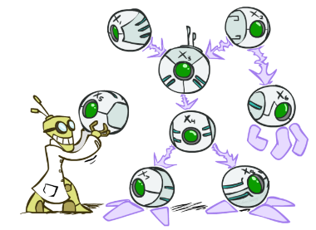
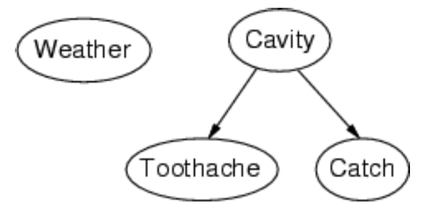
贝叶斯网络
贝叶斯网络：
一种简单的用于表示变量之间条件独立性的有向无环图
结点对应于随机变量 X
有向边连接结点对，表示节点之间的因果关系
每个结点都有一个条件概率分布
P(X | Parents(X))
Notes:
But just how big these UGCs are. On average, in every 60 seconds in social media, two million videos are viewed on YouTube, 700,000 messages are delivered by way of Facebook, 175,000 tweets are fired off into the ether, and 2,000 Foursquare check-ins tell the world where we are. When considered together, one thing seems clear: social media has taken over the world.

Slide 11

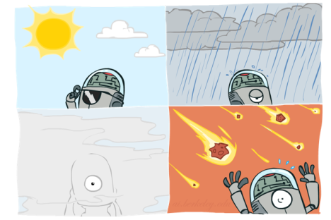
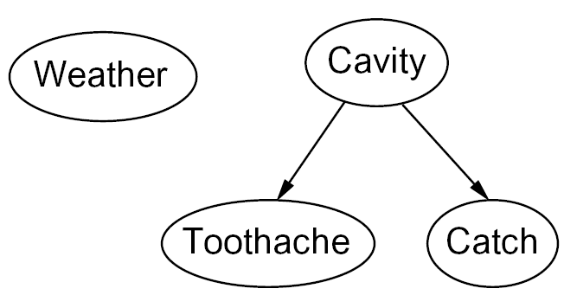
贝叶斯网络例子
条件独立性的网络拓扑结构
Weather独立于其他变量
在给定Cavity的情况下Toothache和Catch相互条件独立
Notes:
But just how big these UGCs are. On average, in every 60 seconds in social media, two million videos are viewed on YouTube, 700,000 messages are delivered by way of Facebook, 175,000 tweets are fired off into the ether, and 2,000 Foursquare check-ins tell the world where we are. When considered together, one thing seems clear: social media has taken over the world.

Slide 12
报警问题条件概率表CPT

Slide 13
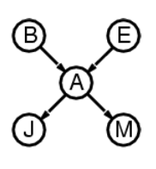
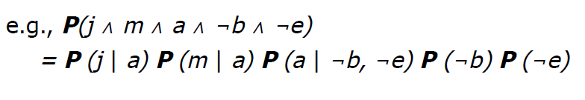
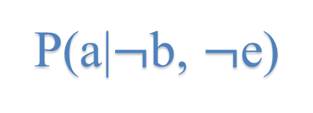
贝叶斯网络的语义
完全联合分布等于局部条件分布的乘积：
P(a|$¬$b, $¬$e)
P(j|a)
P(m|a)

Slide 14
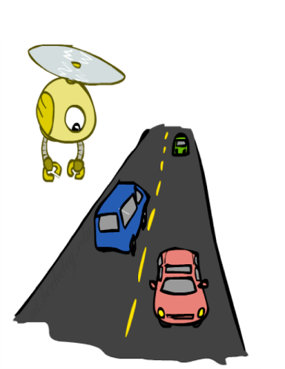
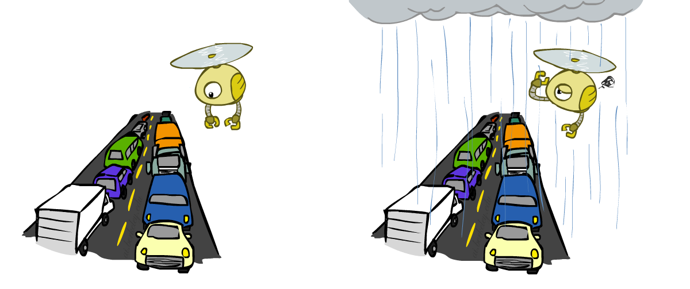


贝叶斯网络：交 通
变量: R:下雨；T:交通
R
+r | 1/4
-r | 3/4
T
+r | +t | 3/4
 | -t | 1/4
P(+r)*P(-t | +r)
-r | +t | 1/2
 | -t | 1/2
试求P(+r, -t )？

Slide 15


构建贝叶斯：交通
+r | 1/4
-r | 3/4
+r | +t | 3/16
+r | -t | 1/16
-r | +t | 6/16
-r | -t | 6/16
R
+r | +t | 3/4
 | -t | 1/4
T
-r | +t | 1/2
 | -t | 1/2

Slide 16
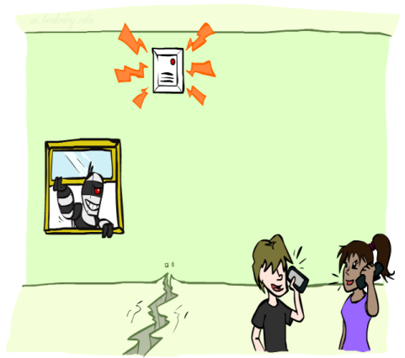
贝叶斯网络: 报警网络
B | P(B)
+b | 0.001
-b | 0.999
Burglary
Earthqk
E | P(E)
+e | 0.002
-e | 0.998
Alarm
B | E | A | P(A|B,E)
+b | +e | +a | 0.95
+b | +e | -a | 0.05
+b | -e | +a | 0.94
+b | -e | -a | 0.06
-b | +e | +a | 0.29
-b | +e | -a | 0.71
-b | -e | +a | 0.001
-b | -e | -a | 0.999
John calls
Mary calls
A | J | P(J|A)
+a | +j | 0.9
+a | -j | 0.1
-a | +j | 0.05
-a | -j | 0.95
A | M | P(M|A)
+a | +m | 0.7
+a | -m | 0.3
-a | +m | 0.01
-a | -m | 0.99

Slide 17
枚举精确推理
当MaryCalls=true, JohnCalls=true时，出现盗贼Burglary的概率是多少？P(b| m, j)
查询变量Burglarym，
证据变量 MaryCalls, JohnCalls
隐藏变量 Earthquake, Alarm
枚举法：
Burglary
Earthqk
Alarm
John calls
Mary calls

Slide 18
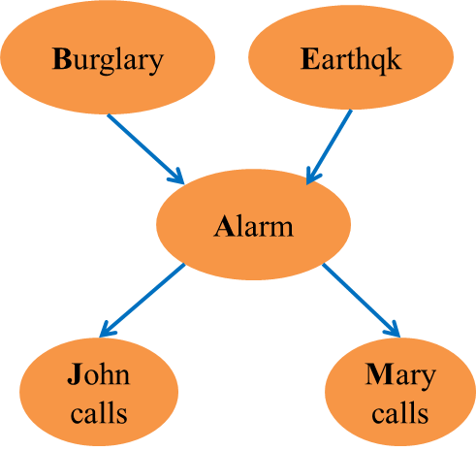
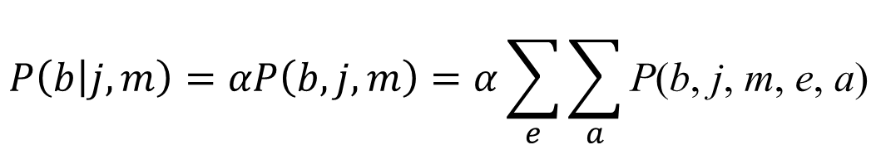
枚举精确推理
$$P\left(b | j, m\right)=αP\left(b, j, m\right)=α\sum_{e}{\sum_{a}{\text{P}\text{(}\text{b}\text{, }\text{j}\text{, }\text{m}\text{, }\text{e}\text{, }\text{a}\text{)}}}$$

Slide 19
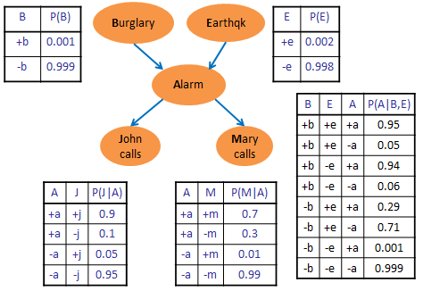
枚举精确推理

Slide 20
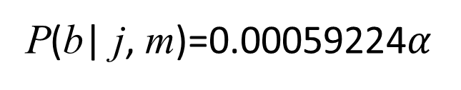
枚举精确推理
计算j=true, m=true的情况下P(b=true)和P(b=false)的概率
P(b| j, m)=0.00059224$α$
归一化得到：

